Slide 1
Object Detection and Recognition I
D E P A R T M E N T O F C O M P U T E R S C I E N C E U N I V E R S I T Y O F C O P E N H A G E N
Kim Steenstrup Pedersen
Notes:
Forelæsning: 23 (2014)

Slide 2
Plan for today
General comments on your solutions to assignment 1
Object detection and recognition?
Interest point based approaches:
SIFT
Notes:
Next year: Add something on bag of features approaches such as Zhang et al IJCV 2007
Consider moving HoG to Object-II (I didn’t manage to talk about HoG the first time around)

Slide 3
Comments to your solutions for assignment 1
Matching: Compare all patches from image A with all patches in image B using NCC. Ok, if you experimented with other descriptors / matching strategies
What was the best patch size?
Remember to answer the questions in the assignment, include figures and make sure we can run your code (e.g. don’t use absolute file paths – only relative paths, specify which libraries/packages you use)
Notes:
Best / 2nd best ratio thresholding appears to work best of your examples.
Patch size? 9x9 or 11x11?
3x3 is too small.

Slide 4
Remember:
If you have to resubmit, do so at the latest on Friday
via the assignment 1 entry in Absalon

Slide 5
Plan for today
Object detection and recognition?
Interest point based approaches:
SIFT
Notes:
Next year: Add something on bag of features approaches such as Zhang et al IJCV 2007
Consider moving HoG to Object-II (I didn’t manage to talk about HoG the first time around)

Slide 6
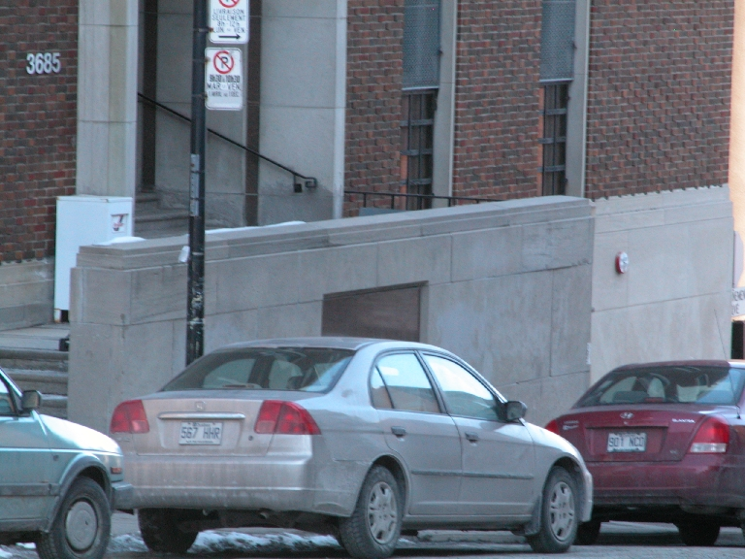
Object detection and recognition
What is in this image?
Where?
Object orientation?
Cars
Window
Lamp post
Notes:
Might include localization of the objects. Common to use bounding boxes to indicate where and the extend of object
Recognition answers the “what” question
Detection answers the other questions

Slide 7
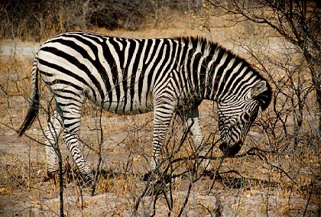
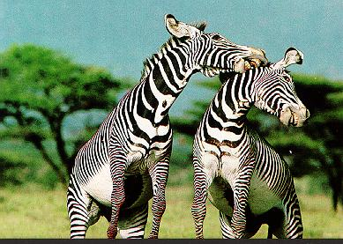
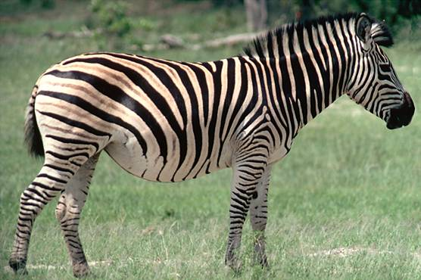
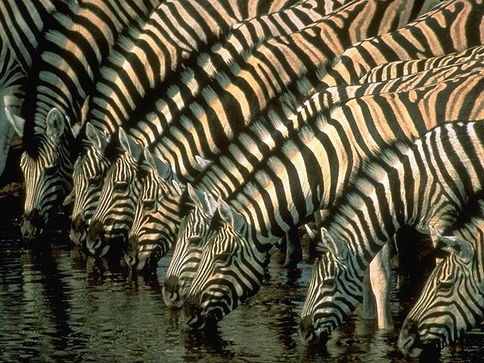
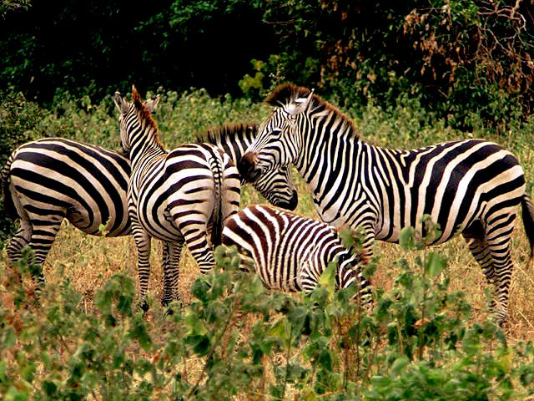
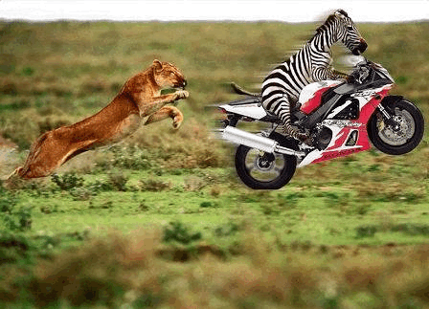
NOT Content-Based Image Retrieval (CBIR)
Search result
Query image
Notes:
Related to CBIR but not the same.
Why?
In CBIR we compare images with images. If one object per image then CBIR is identical to object recognition

Slide 8
Clarification of terms
In CBIR we compare images with images
In object recognition we want to infer whether or not a specific object category is present in an image.
In object detection we want to localize specific instances from object categories in images
Object detection is a harder problem than object recognition and CBIR
Notes:
Recognition: Common to assume that detection / segmentation have been performed. One dominating foreground object

Slide 9
Recognition and Detection Strategies
Interest point based approaches:
SIFT
Dense feature template approaches:
Histogram of Oriented Gradients (HoG)
Deformable parts models (DPM)

Slide 10
Interest point based approaches to object detection

Slide 11
Outline of interest point based approaches
Training:
Detect interest points and extract features on localized object examples
For each object, store in a database a representation of interest points found on the object
Query image:
Detect interest points and extract features
Look up best matching object in the database by matching the interest points

Slide 12
Outline of interest point based approaches
Query image
Recognition and detection
Objects
We will look at object detection by Lowe’04: Can detect specific objects under heavy occlusion and scene clutter

Slide 13
Remember SIFT?
Orientation image
Gradient images
8-bin histograms
Notes:
Recall we for all descriptors both have a location, scale and fiducial/dominating orientation

Slide 14
Interest point based approach using SIFT
Building the object database:
For each object, collect one or more training images of the object.
Training images: One view of object in the image center without background clutter.
For each training image:
Extract (DoG) interest points and SIFT descriptors.
Per interest point store the location, scale, orientation relative to object, as well as SIFT descriptor vector and object label.
Notes:
Draw DB coordinate system and a couple of interest points and point at what is being stored.

Slide 15
Interest point based approach using SIFT
Recognition given a query image:
Detect (DoG) interest points and extract SIFT descriptors in query image.
For all interest points in query image, match SIFT descriptors with descriptors in the object database. This is performed by a nearest neighbor search.
NOTICE: We might match to interest points from different objects in the database.

Slide 16
Recall SIFT matching:
SIFT features are compared with Euclidean distance (L2-norm):
Matching SIFT features:
A match if this is true
Best refers to the distance for the pair of features with smallest distance.
2nd Best refers to the distance for the pair of features with second smallest distance.
Notes:
The sum runs over all the 128 dimensions of the SIFT feature.
Matching: The best match needs to be significantly better than other matches. Best <= Next_Best hence r <= 1

Slide 17
Interest point based approach using SIFT
Recognition given a query image:
Detect (DoG) interest points and extract SIFT descriptors in query image.
For all interest points in query image, match SIFT descriptors with descriptors in the object database. This is performed by a nearest neighbor search.
NOTICE: We might match to interest points from different objects in the database.
For all matched SIFT descriptors:
Find object categories by majority vote among descriptors.
Cluster matching descriptors using Hough voting to handle object occlusion and determine rough estimate of position, scale and orientation.
Improve estimate of position, orientation, scale and shear of object using an affine model.
Notes:
Draw world coordinates with interest points and relate to DB coordinates.
The matching will lead to several potential object hypothesis.
We need to reduce these …

Slide 18
Voting using Hough transform (For each object, estimate position, scale and orientation)
For each potential object category:
For all matching interest points having this object category:
Apply Hough transform to the 4 parameters
Find all local maxima in Hough space with more than 3 points in the bin. These are potential object candidates (one or more detections).
For each object candidate , refine the estimate using an affine transformation model.
Hough transform: A 4 dimensional histogram tilling the parameter space.
Notes:
(x,y) means the location of the object – NOT the interest points.
All interest points in DB stores its relative position on the object – combined with location of match in query we can infer a rough estimate of the object location, orientation and scale.
Do a drawing

Slide 19
Improving the estimate of location, orientation and scale
Using all interest points that vote for candidate in Hough space, improve the estimate by:
Solving for affine transformation parameters – query points and model points
Using all matching points then improve by least squares solution:
Notes:
Affine model accounts for: Translation, rotation, scaling and shearing
Least squares with 6 unknowns so we need at least 3 points to get a solution.
Pseudo inverse instead of inverse (comes from least squares) makes the solution robust and we can use more than 3 points.
Make a drawing of a model object box and and a rotated, scaled and skewed object box with 3 interest points inside and explain the mapping.

Slide 20
Interest point based approach using SIFT (Quick overview)
Post-processing: Check if estimated and interest points in query and database fit closely, otherwise discard.
Decision / classification (scoring): Use a probability model and only accept object detections when we are really sure according to the model.

Slide 21
SIFT Results
Notes:
Robust towards background clutter and heavy occlusions
Big boxes show detected object location and scale (the affine transform) and small boxes show interest points and their orientation and scale

Slide 22
SIFT Results

Slide 23
Problems
This approach:
Only works well for detecting specific objects or well-defined object categories with low intra-class variability
In general:
Inter-class proximity and large intra-class variability

Slide 24
Examples of inter-class proximity (Flowers dataset, Oxford Visual Geometry Group)
Notes:
Different species / classes but appear very similar – hard task even for a human!

Slide 25
Examples of large intra-class variation (Caltech-UCSD Birds 200 dataset – North American birds)
Notes:
The within class variation is very large

Slide 26
Problems
This approach:
Only works well for detecting specific objects or well defined object categories with low intra-class variability
In general:
Inter-class proximity and large intra-class variability
Large variation in view-point and illumination (intra-class variation)
Training objects on cluttered backgrounds

Slide 27
Variations in view point, illumination, clutter (DPM results – more on this next lecture)
Notes:
Pretty robust towards changes in view point, scale and illumination
Some failures: School bus under cars, cow and plane part under horse.

Slide 28
Summary
Object detection and recognition is harder than CBIR
Interest point based approaches:
SIFT

Slide 29
Literature
Reading material:
Lowe IJCV 2004 (Sec. 7 – 9)

Slide 31
TODO: Problem classes in object recognition. Maybe move to Object-II lecture?
Recognition: Common to assume that detection / segmentation have been performed
Object hierarchies
Hierarchies of objects
Inter-class versus intra-class variability: Large intra-class variation is a hard problem

Slide 32
Classification 101
TODO: Do we need this?

